Slide 1

Statistics
Aishwarya mate

Slide 2
Agenda
What is statistics?
Need of Statistics
Types of Statistics
Descriptive Statistics
Inferential Statistics

Slide 3
What is Statistics?
Statistics is the science of collecting, organizing, analyzing, interpreting, and presenting data to extract meaningful insights and support decision-making.
Key Functions of Statistics:
1️⃣ Collection of Data: Gathering data through surveys, experiments, observations, and transactions.
2️⃣ Organization of Data: Arranging data in tables, charts, and graphs for easier understanding.
3️⃣ Analysis of Data: Applying methods to summarize and find patterns (mean, median, standard deviation, etc.).
4️⃣ Interpretation of Data: Drawing conclusions from analyzed data (e.g., customer trends, market demand).
5️⃣ Presentation of Data: Displaying data visually using charts, dashboards, and reports for stakeholders.

Slide 4
Need of Statistics
1️⃣ To Make Informed Decisions Statistics helps convert raw data into meaningful insights, enabling data-driven decision-making in business, healthcare, education, and daily life.
Example:
A business decides on stock levels based on average monthly sales.
A hospital monitors patient recovery trends to improve treatment plans.
2️⃣ To Summarize Large Data Datasets can have thousands of records. Statistics allows us to summarize this into understandable values like mean, median, and visual charts.
3️⃣ To Identify Patterns and Trends Helps in understanding patterns in data (e.g., seasonal sales trends, customer purchasing behavior).

Slide 5
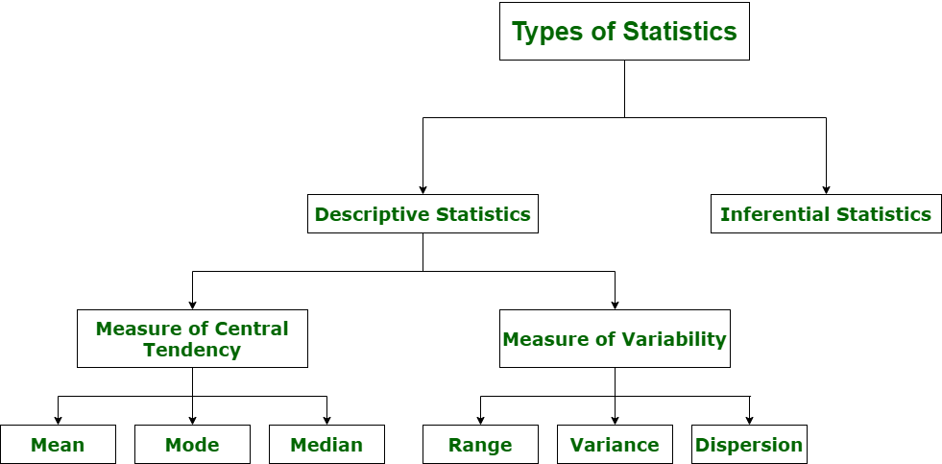
Types of Statistics

Slide 6
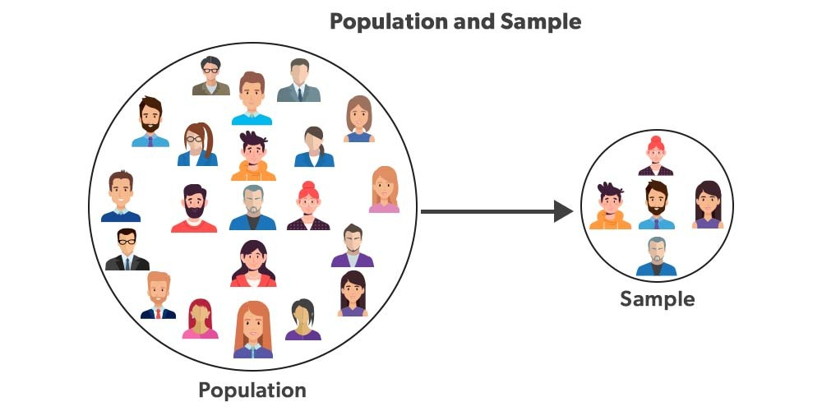
Population and Sample

Slide 7
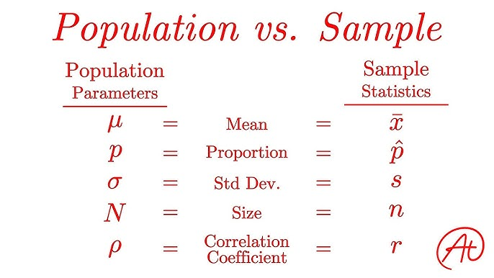
Terms

Slide 8
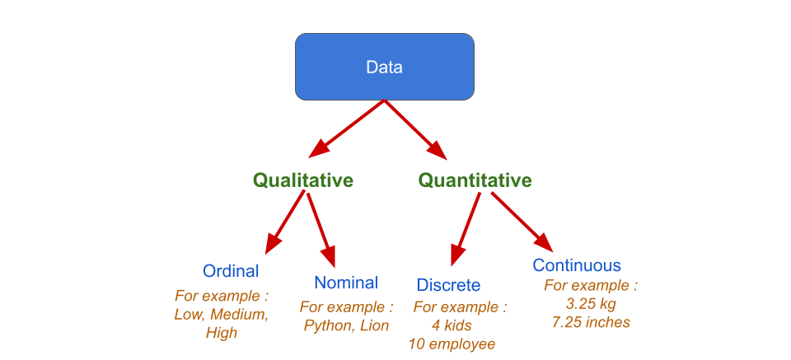
Data types

Slide 9
Descriptive Statistics
Descriptive Statistics involves methods to summarize, organize, and present data in a clear and understandable way.
It describes the basic features of data without making predictions or inferences.
Purpose of Descriptive Statistics:
To simplify large amounts of data into understandable summaries.
To identify patterns, trends, and distributions in data visually and numerically.

Slide 10
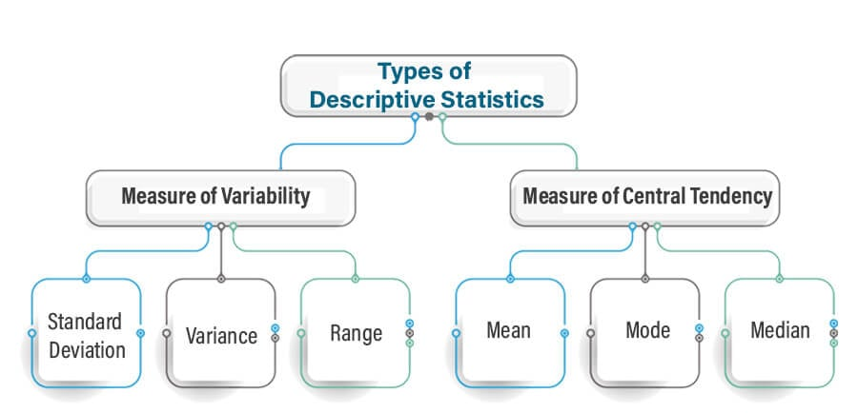
Types of Descriptive Statistics

Slide 11
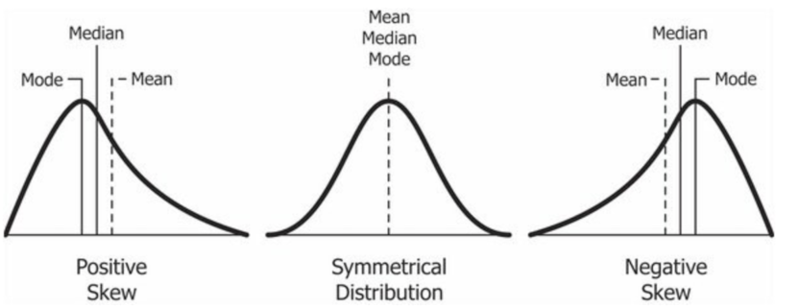
Skewness

Slide 12

Measures of Central Tendency
Mean (Arithmetic)
The mean (or average) is the most popular and well known measure of central tendency. It can be used with both discrete and continuous data, although its use is most often with continuous data. The mean is equal to the sum of all the values in the data set divided by the number of values in the data set.
The mean salary for these ten staff is $30.7k.

Slide 13
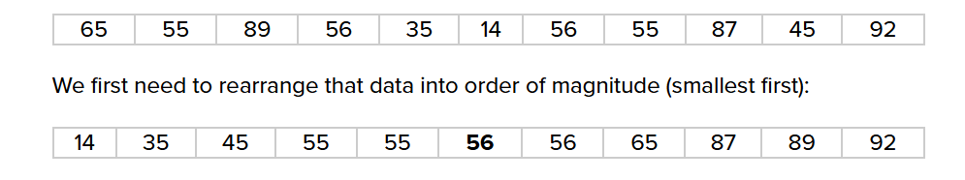
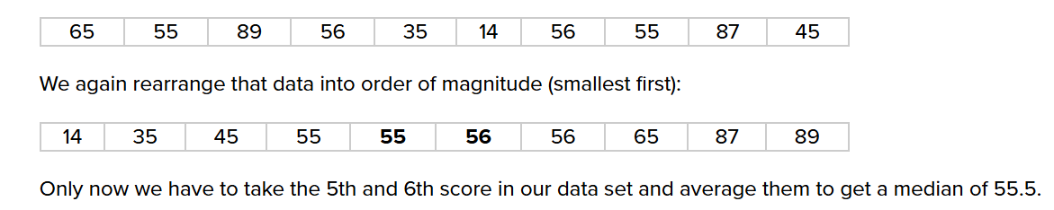
Median
Median
The median is the middle score for a set of data that has been arranged in order of magnitude.
ODD =

Slide 14
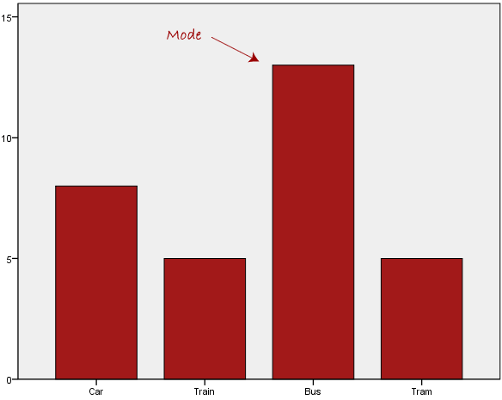
Mode
Mode
The mode is the most frequent score in our data set.

Slide 15
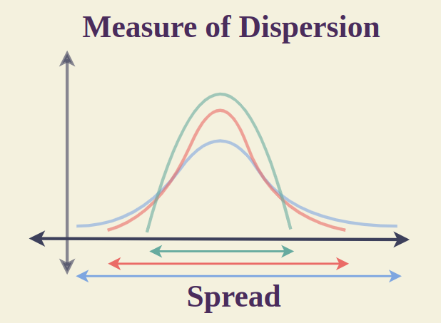
Measures of Dispersion/ Variance
Measures of dispersion help to describe the variability in data. Dispersion is a statistical term that can be used to describe the extent to which data is scattered.
Thus, measures of dispersion are certain types of measures that are used to quantify the dispersion of data.

Slide 16
Why is it needed?

Slide 17
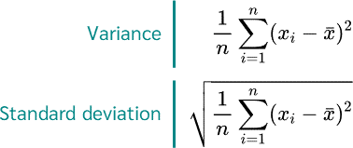
Dispersion

Slide 18
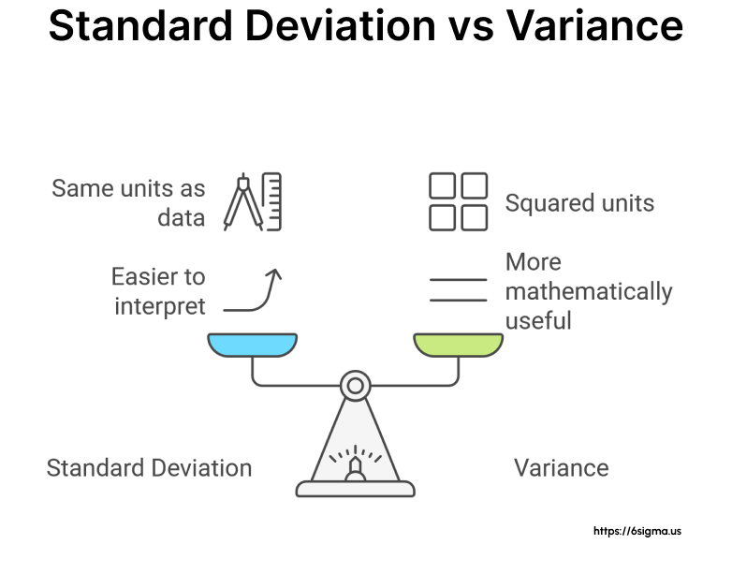

Slide 19
Interpretation

Slide 20
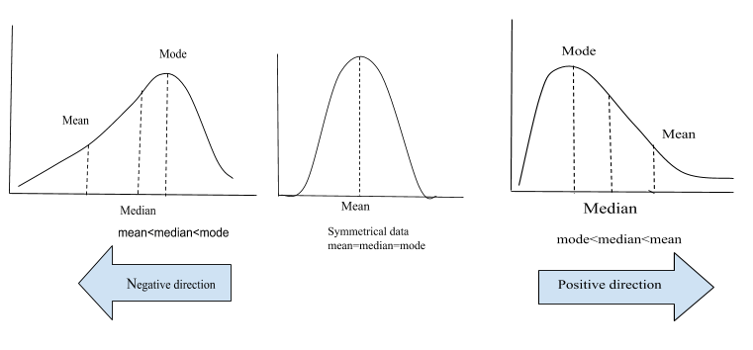
Skewness
Skewness is the measure of asymmetry in the dataset!

Slide 22
Thank You!

